Slide 1


Networking Basics
Week 7
Summary
Address Types and Basic Subnetting
Yvan Perron
CST8103 - Fall 2012

Slide 2
Topics
Calculating the three Address Types
Basic subnetting

Slide 3
Address Types
There are three types of addresses within the address range of every network segment:
Network, host and broadcast
Network Id
All host bits are 0s
Broadcast address
All host bits are 1s
Host addresses
network + 1 to broadcast -1
Maximum number of hosts in network
2^h-2
Remember, the network portion is identical for ALL addresses of same network segment

Slide 4
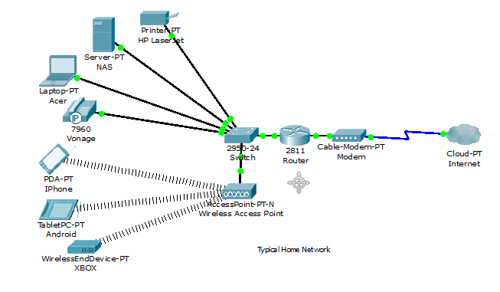
192.168.15.0/24

Slide 5
Subnetting
Creating multiple networks from a single address block.
Subnetting was necessary as we were running out of address blocks that could be allocated to organizations.
We had to abandon the old classful addressing scheme.

Slide 6
Subnetting - Illustrated
Subnetting process illustrated
Start with the mask of our base IP address
11111111111111111111111100000000
n=24 h=8
Transform host bits into network bits – our new mask
11111111111111111111111111110000
Result of subnetting
b=4 n=24 New h=?
32=b+n+h
h=32-(b+n)
Subnets = 2^b
Hosts per subnet = 2^h-2

Slide 7
Subnetting Formulas
Formulas and variables
h=number of host bits (after borrowing)
b=number of host bits transformed into network bits (aka borrowed bits)
n=number network bits (base mask)
h+n+b=32
Number of new networks resulting from the subnetting:
2^b
Number of hosts per new network
2^h-2

Slide 8
End

